Slide 1
CS5223 Distributed Systems
Lecture 4: Naming
Instructor: YU Haifeng

Slide 2
Today’s Roadmap
Chapter 5 of textbook
P2P and DHT is a important topic and will be covered in a separate lecture
Basic concepts in naming
Simple naming mechanisms
Domain name service

Slide 3
Motivation for Naming
Example: We want to visit www.nus.edu.sg
The web server is located in some room that we don’t know
There may be multiple web servers
ISP’s may want to serve the content from their own machines – Akamai
www.nus.edu.sg → ip address → some physical machine (with specific MAC address)
Example: Distributed file system
We know the file name (and full path), need to find out where the file is (i.e., on which machine, which disk sector, etc)
The file may migrate from one machine to another without changing its name

Slide 4
Basic Concepts in Naming
General definition for naming:
We have a “name” and we want to find/locate the “entity”
Definitions in the textbook is unnecessarily convoluted, and sometimes circular – please ignore those
A lot of things can be called “naming” – just a definition issue – no need to draw a black-and-white boundary
Name space: The set of all possible names in the given context
Naming system: The system that enables you to find the “entity”
Name resolution
The naming system can be either non-distributed or distributed
Same tradeoff as before…

Slide 5
Different Kinds of Names
Every name is a bit string
Some are human-friendly
Hierarchical versus flat
Alias
Multiple names for the same entity
Similar as symbolic links

Slide 6
Merging Name Spaces
We have two different name spaces
Now we want to define a unified name space
Name space merging
Generalizes to multiple name spaces…how?
Example: Merging two network file systems
Example: Two users want to give each other access to files in their home directories
Main issue to take care of: There can be name collisions

Slide 7
Solution 1: New Root Node
Merge by adding a new root node and make existing root nodes its children
In principle, you always have to start in the new root
But you can avoid this by including the identifier of node from where resolution should start
Example, ~/XXX
Problem: existing names need to be changed

Slide 8
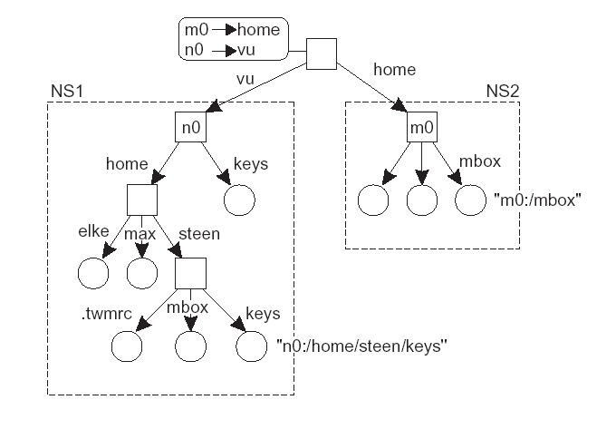
Example: New Root Node

Slide 9
Solution 2: Mounting
Introduce nodes that contain the name of a node in a “foreign” name space
Mount point: (Directory) node in naming graph that refers to other naming graph
Mounting point: (Directory) node in other naming graph that is referred to

Slide 10
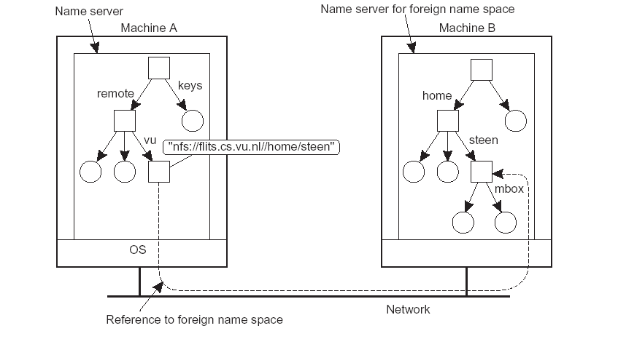
Example of Mounting
Mounting
Point
Mount Point

Slide 11
Simple Naming: Broadcast
The “naming system” may or may not be a stand-alone software module
Broadcast to resolve a name
Used in early day of computing
Simple is good!
Drawback: performance
Alleviated but not fully addressed by using multicast

Slide 12
Simple Naming: Forwarding Pointers
Forwarding pointers: Same idea as mail forwarding
The machine A with ip_addr1 was initially the web server for www.nus.edu.sg
We want to use another B machine now with ip_addr2 as the server
A will forward the HTTP requests to B
Or A can inform the client of B’s address
Drawback:
A needs to stay there forever
The forwarding chain can become long

Slide 13
Simple Naming: Home-Based Approach
Each entity has a “home”
The entity will register its IP address (which may change) with its home
To find the entity, we contact the home first
Only minor difference from forwarding pointers
Maximum one-hop forwarding
Drawback:
The home needs to be there forever (i.e., have a fixed IP address)

Slide 14
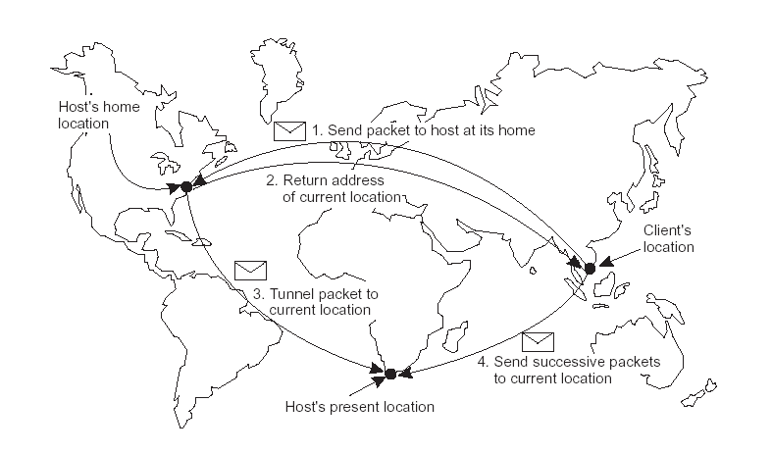
Example: Home-Based Approach

Slide 15
Domain Name System: DNS
For looking-up IP addresses
Example: what ip address www.nus.edu.sg corresponds to
DNS dates back to over 30 years ago
Replaces the original Internet naming scheme that keep everything in a master file (lack of scalability and freedom for each domain to assign internal names)
Overall, DNS has been a very successful distributed system
Many of the early design decisions turn out to be critical later
Additional reading (non-compulsory): “Signposts in cyberspace: The Domain Name Systsme and Internet Navigation” by R. Levien, National Academic Research Council, 2005
We will study it as a case study…

Slide 16
Side-track: The Role of Case Studies
RMI: Case study for RPC
DNS: Case study for naming system
Distributed systems has two aspects
Algorithms: Science – can rigorously prove things, can reason about properties mathematically
End-to-end systems: Art – too complex to capture mathematically
How to do better art
Subjective judgment based on one’s knowledge and experience
Experience comes from case studies
It is easy to miss some aspects when thinking about designs on paper
This has a strong analogy to law and history
In certain law systems, arguments are made by drawing connection to historical law suits

Slide 17
DNS Name Space
DNS name (max length 255)
www.comp.nus.edu.sg/~yuhf
label (max length 63)
Top-level domains
com, edu, net, org, etc.
sg, cn, fr, etc.
The machine corresponding to XXX.XXX.sg may or may not be in Singapore

Slide 18
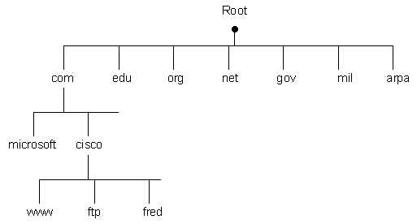
The DNS Tree
(from http://www.rhyshaden.com/dns.htm)

Slide 19
Relative Names in DNS
Not supported in DNS specification
However:
Your local software may automatically append the omitted part
Example, you can type ssh suna on any SoC unix machine, and you will connect to suna.comp.nus.edu.sg
If suna.comp.nus.edu.sg does not exist, ssh will try to connect to “suna” (which does not exist either)
Sometimes the local software may try appending different suffixes

Slide 20
Domains in DNS
A domain is a name space for which there is a single overall administrative authority to assignment the DNS names
Example, the collection of all XXX.nus.edu.sg is a domain
A domain’s name is the common suffix of all the DNS names in the collection
Example, nus.edu.sg is the domain’s name
By definition, a domain’s name is also a DNS name
Potential confusion
A DNS name is sometime called domain name, which is different from domain’s name defined above
We will only use DNS name and domain’s name to avoid confusion

Slide 21
Resolving DNS Names: The Perspectives of a Client
Web browser
Make query to DNS server (how to find the DNS server?) to resolve www.nus.edu.sg into an IP address
Send HTTP request to that IP address at port 80
ftp, telnet, ssh, smtp(email) are all similar
Reverse resolution:
Translate an IP address into a DNS name
Only for IP addresses within the local domain

Slide 22
Resolving a DNS Request
The client needs to know the “local DNS server”
The IP address of this server is given to you by your ISP
Bootstrapping
Client sends DNS query to local DNS server S
Containing the DNS name e.g., www.nus.edu.sg
S checks whether it has either authoritative RR or cached RR for
www.nus.edu.sg
nus.edu.sg
sg

Slide 23
Root DNS servers
If no, S will send quest to the root DNS server
How does S know where to find the root DNS server?
13 root servers with well-known IP addresses
https://www.iana.org/domains/root/servers

Slide 24
Resolving a DNS Request
The root DNS server sends back to S the IP address of the DNS server responsible for the domain “sg”
S contact that DNS server
And then recursively the DNS server for “edu.sg”, “nus.edu.sg”, …
After a DNS name is resolved, the RR will be cached

Slide 25
Critical Design Decisions in DNS
Delegation of responsibility
Allow individual domains to assignment their own DNS names
Hierarchical naming strcuture
Caching and replication
Controls the overhead of DNS lookups
Controls the load on the root DNS servers

Slide 26
Vulnerability of DNS
The root servers – “single points” of failure
Target of DoS attacks
Already happened
Alternatives:
Completely decentralized distributed naming system for the Internet
Already possible technically, but backward-compatibility issues need to be addressed

Slide 27
History Readings (Non-compulsory)
DNS root servers under attack
http://en.wikipedia.org/wiki/DNS_Backbone_DDoS_Attacks

Slide 28
The Fundamental Need for Bootstrapping in Naming
To resolve a name, you need to know at least one bootstrapping point
Broadcast: Bootstrapping point not needed (or every machine is a bootstrapping point?)
Forwarding pointers: The first machine you contact
Home-base approach: The home
DNS: Your local DNS server and the root DNS servers
Called “closure mechanism” on the textbook
Bootstrapping mechanism significantly influences the “goodness” of a naming system

Slide 29
Today’s Summary
Basic concepts in naming
Simple naming mechanisms
Domain name service

